Slide 1
Does the Earth’s magnetic field influence the arrival direction of particle showers?
(Fancy: Largescale Anisotropies and Potential Geomagnetic Effects)
or: The East-West Effect (maybe)

Slide 2
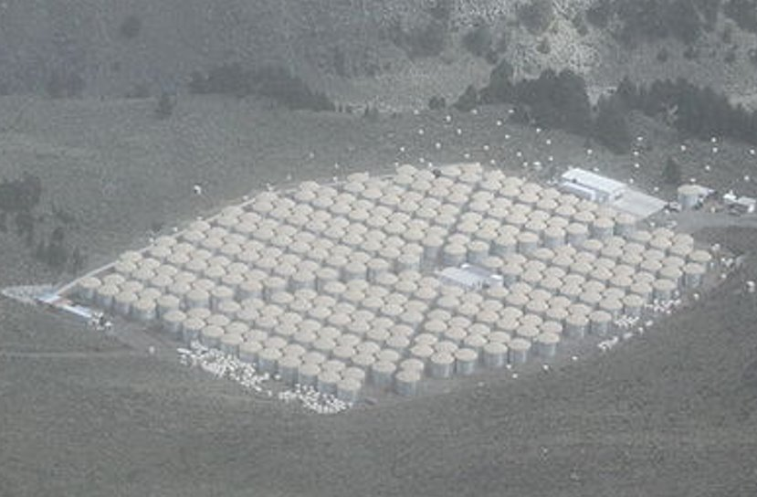
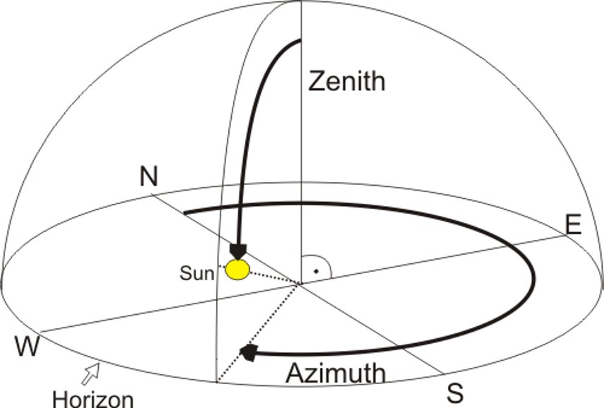
Detector Coordinates
Azimuth is measured counterclockwise from east on the array

Slide 3
Aside: Data Collection
Data is collected by the array in runs
Runs are put through the Offline Reconstructor which does its best to determine arrival direction (among other things), quality assurance (we may determine some runs are bad)
These runs are uploaded to be used for research

Slide 4
What do we expect?
The azimuth distribution should be flat
The zenith distribution should show few/no effects at 0 and 90 and be peaked somewhere in between

Slide 5
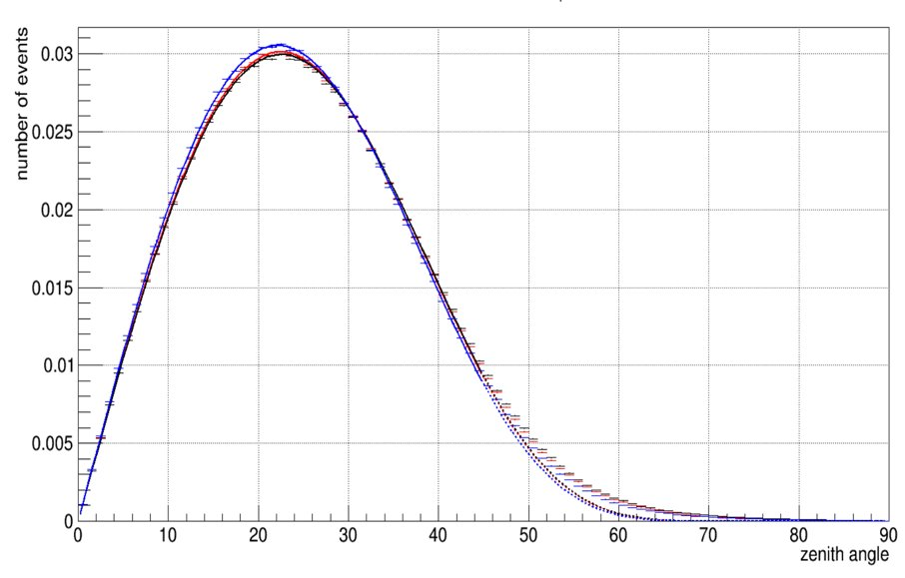
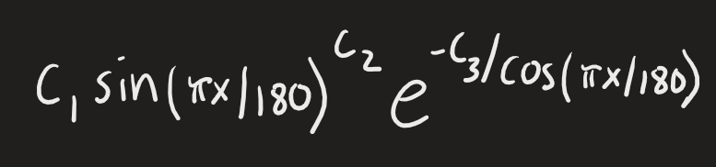
We do we actually get? - Zenith
✓
[0]*TMath::Power(sin(pi*x/180.),[1])*exp(-[2]/cos(pi*x/180.))

Slide 6
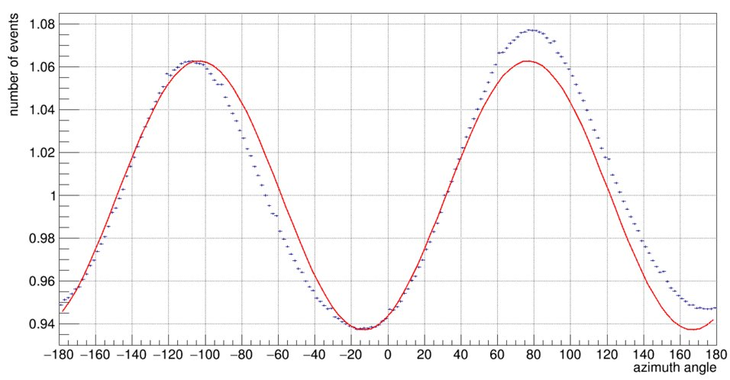
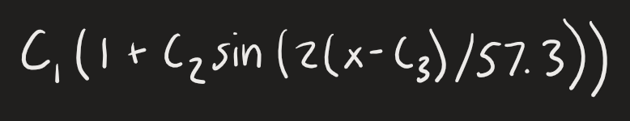
We do we actually get? - Azimuth
✗
[0]*(1+[1]*sin(2*(x - [2])/57.3))
[0]-> Fixed to 1, [1]-> amplitude, [2]-> phase

Slide 7
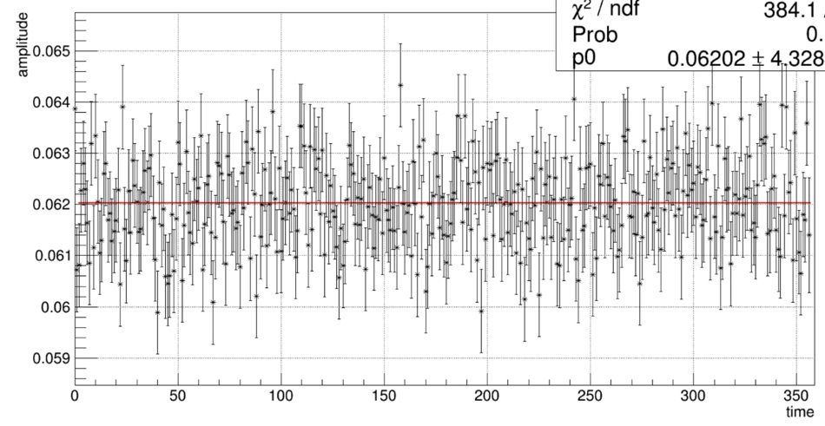
Is this an issue for data analysis?
No – the amplitude is roughly constant in time

Slide 8

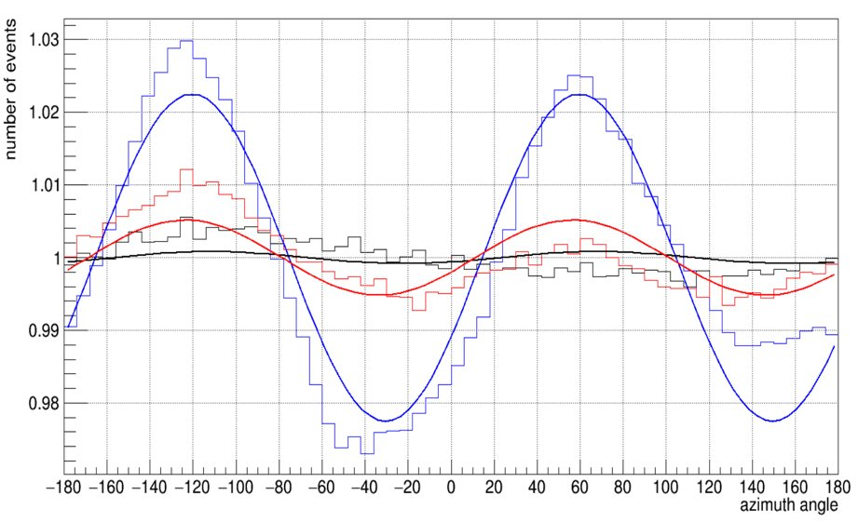
Understanding the effect
Zenith distribution does not change for different azimuth angles
Azimuth distribution changes for different zenith angles, but only in amplitude

Slide 9
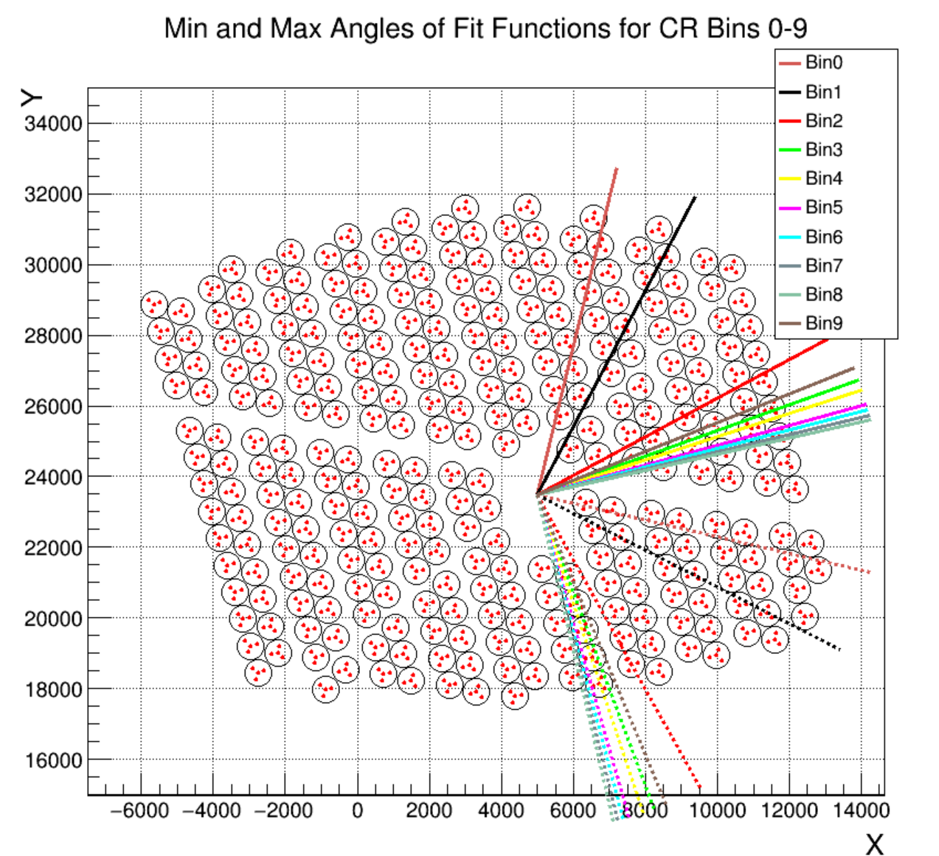
Event size increases from nHit bin 0 to 9 and event size is a proxy for energy

Slide 10
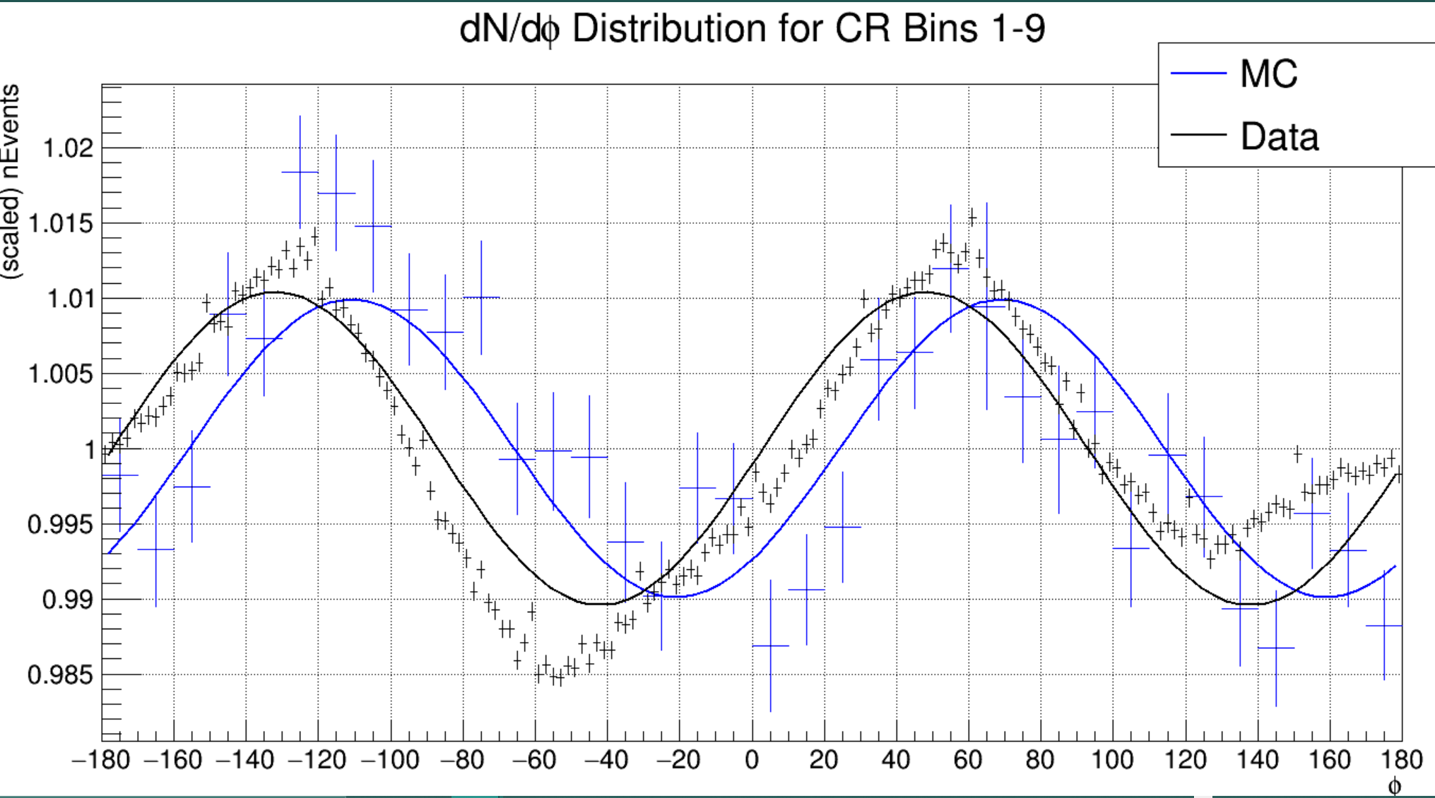
How does the data compare with Monte Carlo?
Monte Carlo is composed of simulated air showers that are thrown on the array and reconstructed

Slide 11
Other Stuff
Core locations
Different cuts
Slices
Proton simulations
I looked at a lot of other stuff

Slide 12
Potential Explanations
Bad luck – effect was there 4 years ago and is still here today, MC
Array geometry
There is an alley through the middle of the array – peaks/valleys don’t line up with the alley
PMT trigger cascades – um no
The mountains – it’s not the mountains
Earth’s magnetic field - ?

Slide 13
Jump to today: modelling
The goal is to simulate air showers that are detected by the array when there is no magnetic field present
If we can compare this to current data then we’ll know definitely if the Earth’s magnetic field is responsible for the effect we see

Slide 14
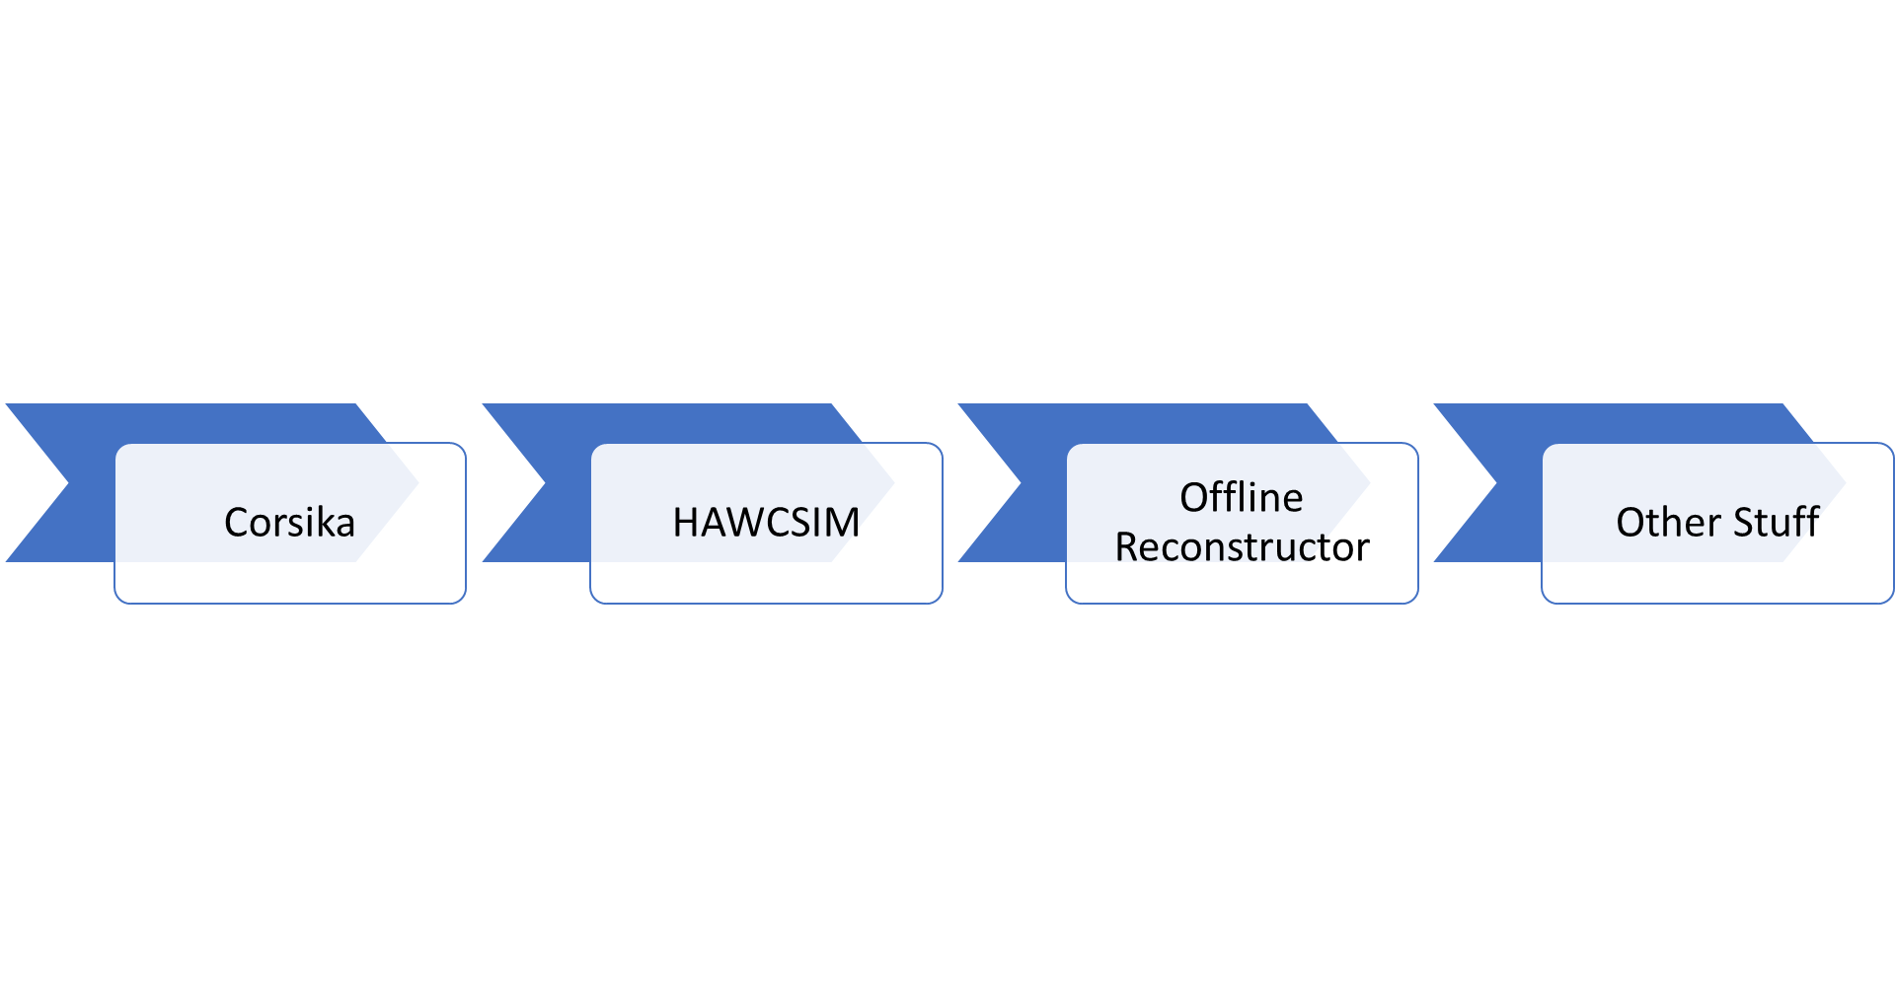
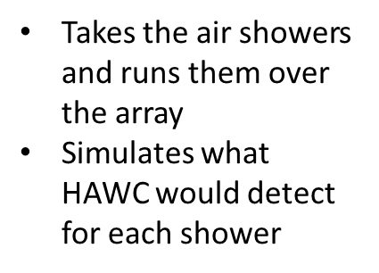
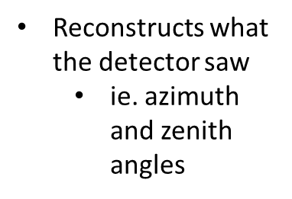
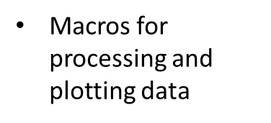
Work Flow
Generates data files for air showers
I can specify parameters for the showers

Slide 15
What gives?
HAWCSIM is pretty new (at least for what I’m using it for)
There is little documentation and no one really knows how it works
Random bugs!
First, I have to ensure that I can reconstruct similar to the data with the correct magnetic field
HAWCSIM is a huge pain with how it throws cores
There is a discrepancy between HAWCSIM and the OR when it comes to core locations and offsets
I can fix the HAWCSIM core locations but then the OR is upset

